Slide 1
Predicting Student Performance Using Machine Learning Final Portuguese Grade (G3_por) Prediction
Presented by: Ganesh Sura Date: 04-08-2025

Slide 2
Objective
Predict final Portuguese grades (G3_por)
Use academic, demographic, and lifestyle features
Apply machine learning models and evaluate performance

Slide 3
Dataset Overview
Source: UCI Machine Learning Repository
162 merged student records (Math + Portuguese)
Target: G3_por (final Portuguese grade)
Key Features:
Academic: G1_por, G2_por, studytime, failures
Lifestyle: goout, Dalc, Walc
Family: Medu, Fedu, internet

Slide 4
Data Preprocessing
Dropped redundant features (G1_mat, G2_mat, G3_mat)
Engineered features:
ParentEduAvg = (Medu + Fedu)/2
TotalAlcohol = Dalc + Walc
OneHotEncoded categorical variables
Scaled numerical data using StandardScaler

Slide 5
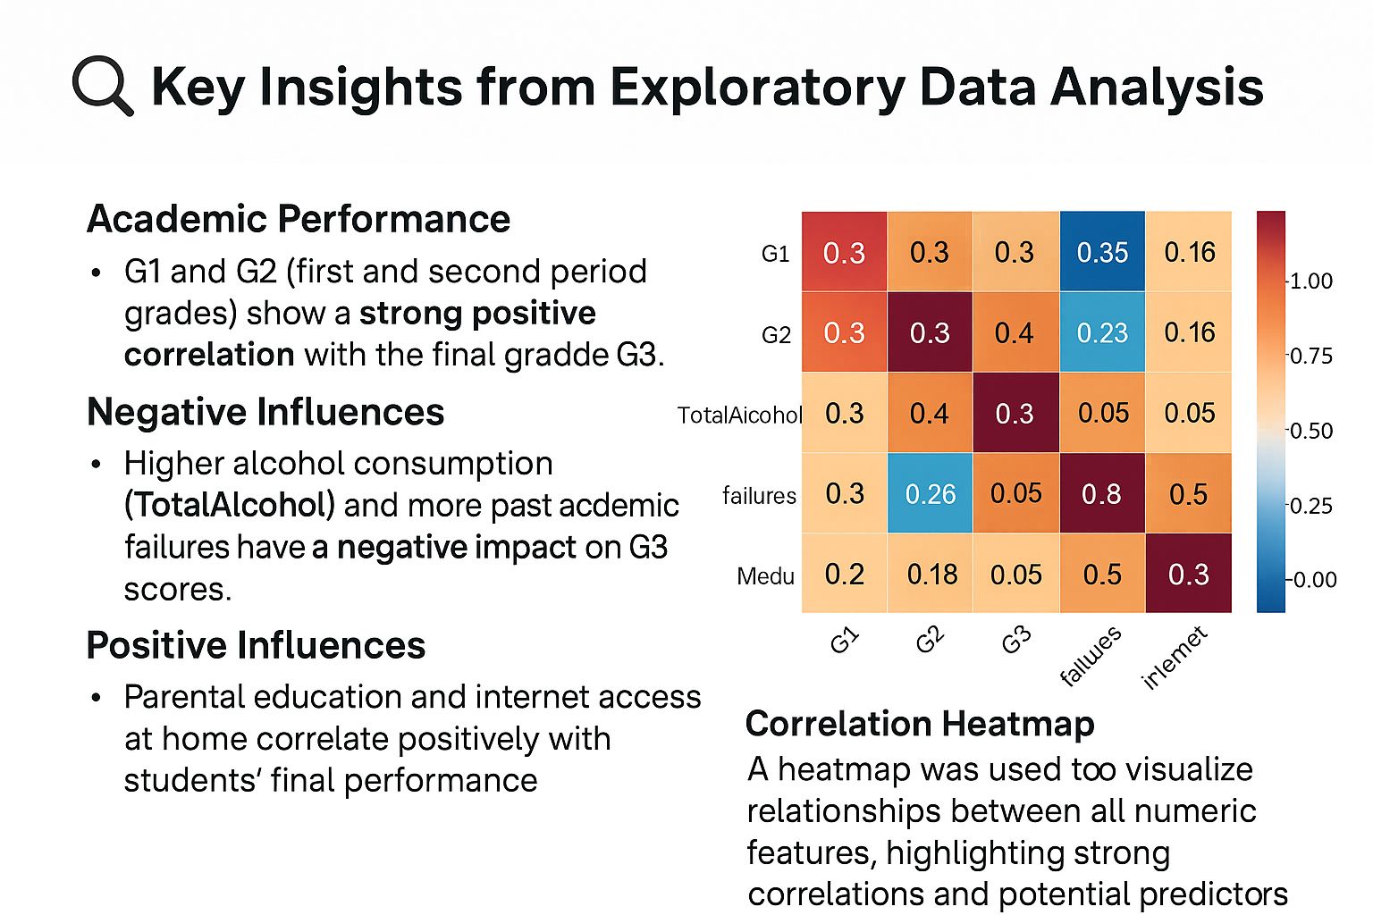
Exploratory Data Analysis
G1 & G2 strongly correlate with G3
TotalAlcohol, failures negatively impact G3
Parental education, internet access show positive trends
Heatmap used to visualize correlations

Slide 6
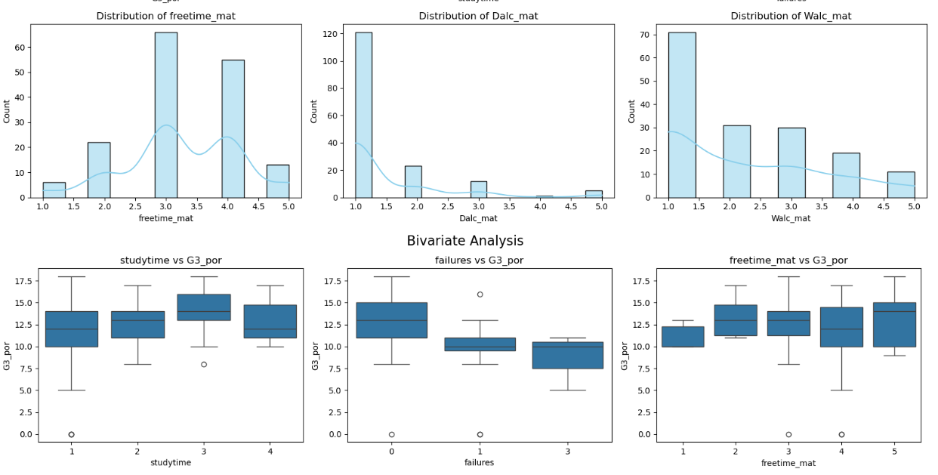

Slide 7
Modeling Approach
Models used:
Linear Regression
Decision Tree Regressor
Random Forest Regressor
Ridge & Lasso Regression (with GridSearchCV)
Evaluation metrics:
R² Score
MAE (Mean Absolute Error)
RMSE (Root Mean Squared Error)

Slide 8
Model Performance
Model | R² Score | MAE | RMSE
Linear Regression | ~0.66 | 1.28 | 1.86
Decision Tree | ~0.81 | 0.83 | 1.39
Random Forest | 0.72 | 1.02 | 1.68

Slide 9
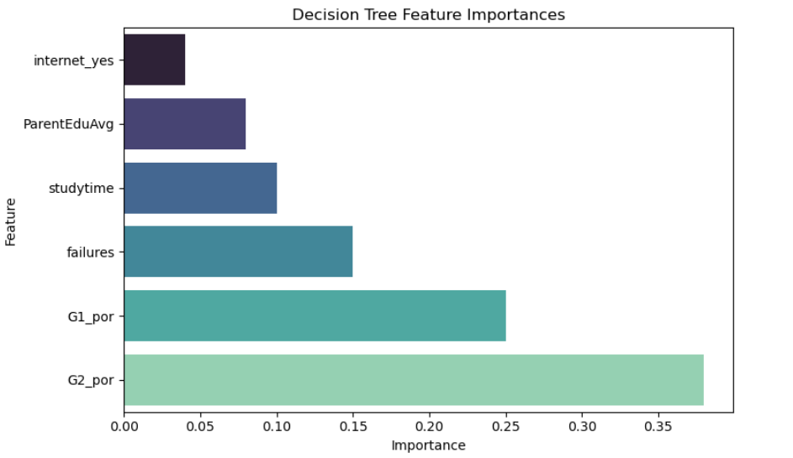
Feature Importance (Decision Tree)

Slide 10
Conclusion
Random Forest performed best (R² = 0.7637)
Strong predictors: G2, G1, failures, alcohol use
ML models can support early intervention for students
Potential for deployment in academic support tools

